Slide 1
Variant calling from NGS data of two accessions of Lablab purpureus
Group-06 members; Immaculate Nahereza, Jane Njeri, Winfred Gatua, Nsangi Olga Tendo, Davis Kiberu, Nsubuga Moses, Eneza Yoel
Supervisors; Jean-Baka Domelevo Entfellner, Oluwaseyi Shorinola, Peter Emmrich

Slide 2
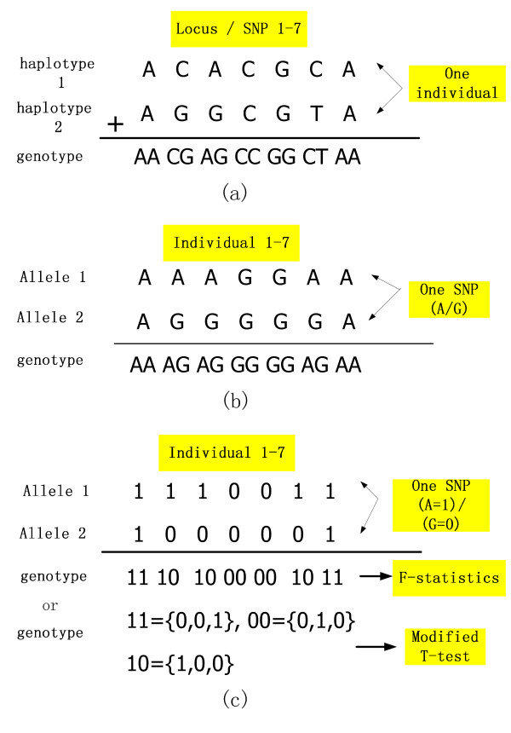
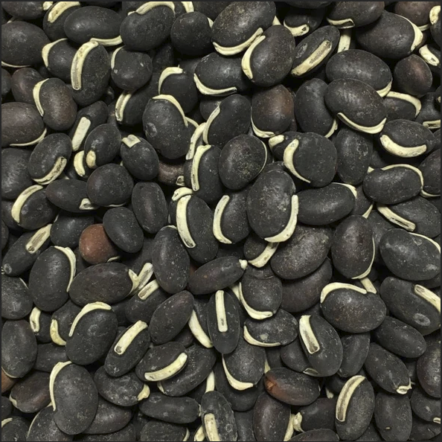
BACKGROUND
Lablab purpureus is a bean (family Fabaceae) commonly known as “lablab” which is native to Africa and widely cultivated in East Africa.
It is called “Njahi” or black beans in Kenya where it is an important part of the daily diet.
Lablab is, however, still an orphan crop with limited genomics and genetics resources.

Slide 3
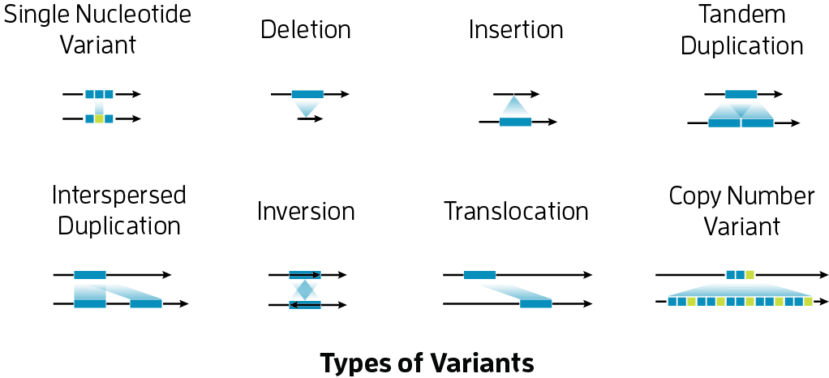
Variant types
Variant calling is widely used genetics as a way of identifying variants associated with a specific trait, population or hereditary diseases.

Slide 4
objectives
To do denovo assembly using Illumina based and Oxford nanopore based 147D reads.
To create a variant calling pipeline for Lablab purpureus
To convert the pipeline to a reproducible and portable snakemake workflow.

Slide 5
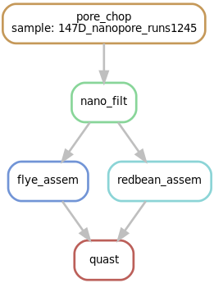
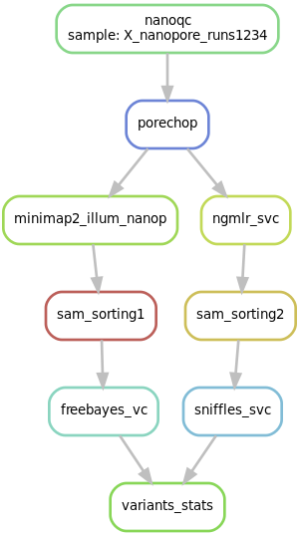
Pipeline
Assembly
Variant calling

Slide 6
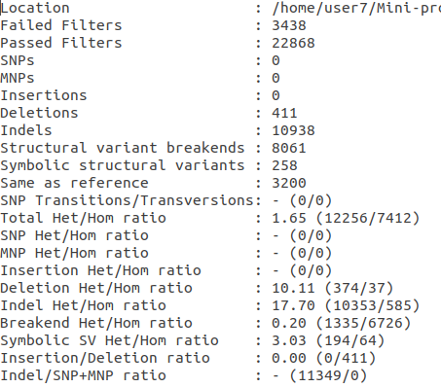
Obtained statistics

Slide 7
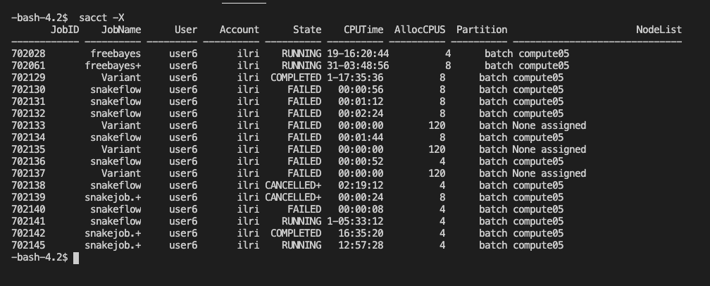
Ongoing analysis

Slide 8
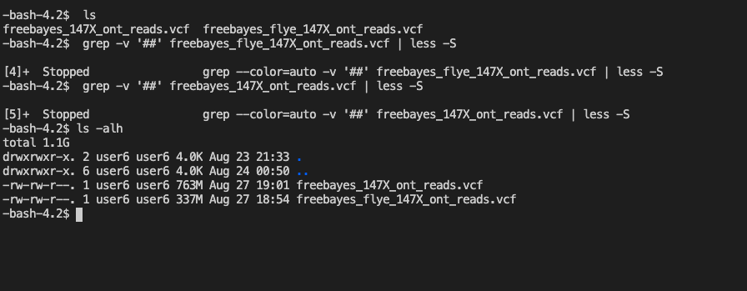
Ongoing analysis

Slide 9
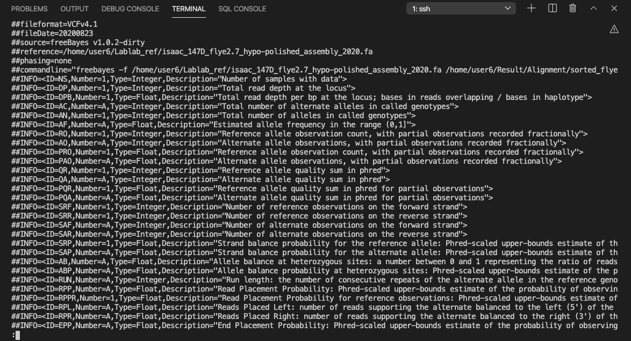
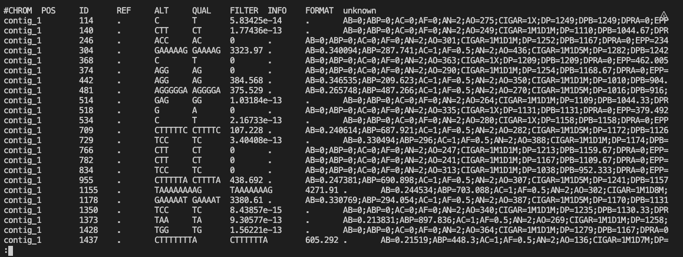
Ongoing analysis

Slide 10
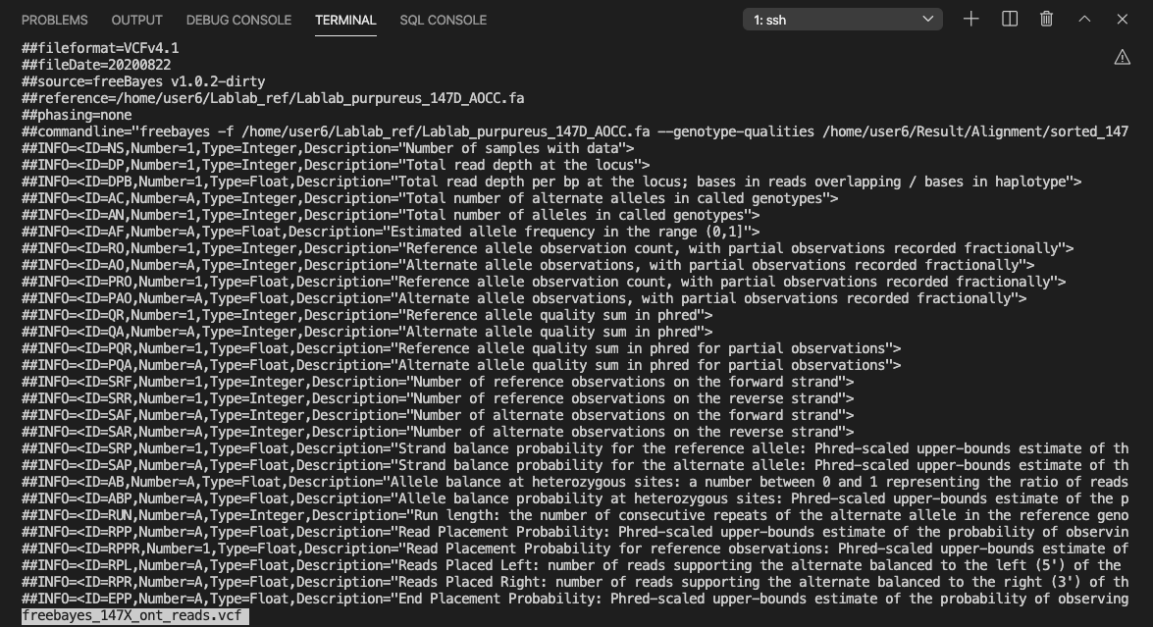
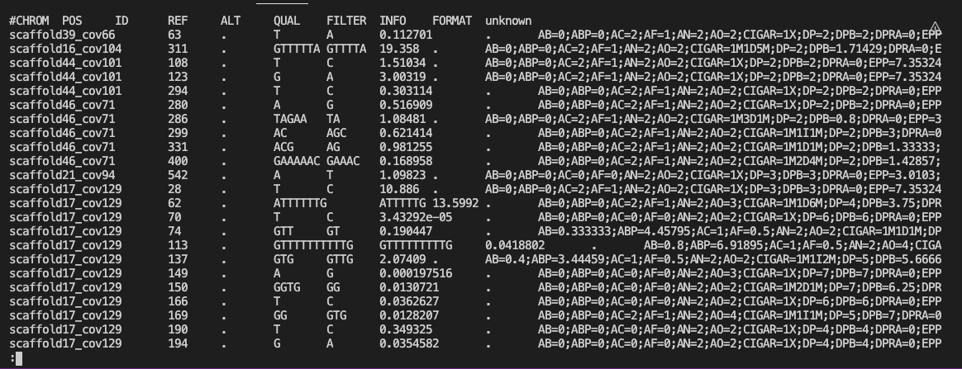
Ongoing analysis

Slide 11
Snakemake workflow
Create an environment with all the packages needed
$conda env create –-name variant --file Config.yaml (exported env)
Do a dry run snakemake
$Snakemake –np
Run Snakemake
$Snakemake -j
https://github.com/enezermjema/Mini-project-group-06

Slide 12
Lessons
Different tools that are used for Oxford Nanopore reads
Working with long reads is computationally intensive
Minimap2 alignment not compatible with sniffles

Slide 13
challenges
Computational resources
Error correction prolonged due to working remotely

Slide 14
Group members
Supervisors; Jean-Baka Domelevo Entfellner,
Oluwaseyi Shorinola,
Peter Emmrich

Slide 15
Thank you!

